Slide 1
Potential Upgrades to the LENA Detector System
David Little

Slide 2
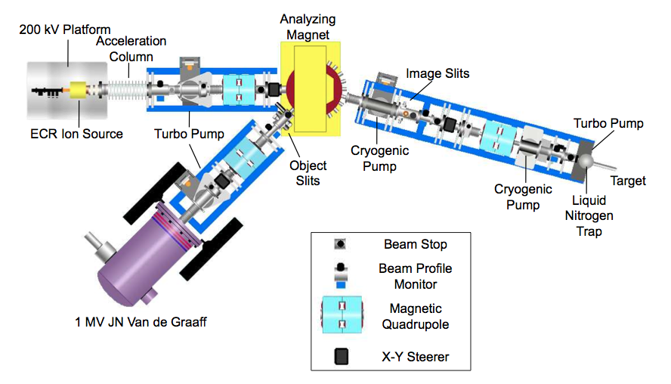
Laboratory for Experimental Nuclear Astrophysics (LENA)

Slide 3
Laboratory for Experimental Nuclear Astrophysics (LENA)

Slide 4
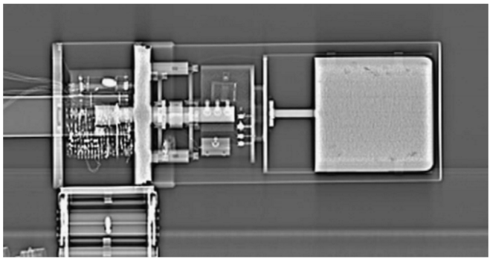
Present LENA HPGe Detector
Thoroughly characterized
P-type coaxial HPGe detector
91.6 mm deep and 89 mm in diameter
Dead layer of 1.5 mm
Surrounded by 16 NaI(Tl) scintillators
S. Carson, et al., Nucl. Instrum. Methods A
NaI annulus
Beam pipe
HPGe detector

Slide 5
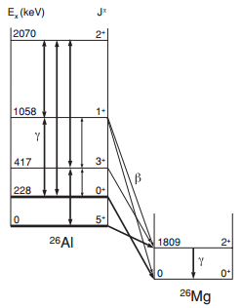
My Reaction: ²⁵Mg(p,γ)²⁶Al
Astrophysically relevant
Specifically want to examine the 92 keV resonance
Important for massive stars (temps between 40-90 MK)
Very weak resonance strength (2.9 x10⁻¹⁰ eV)
Nothing else is known
Likely to fall below our present detection limits
Iliadis et al. 2011

Slide 6
WHAT DO WE DO?

Slide 7
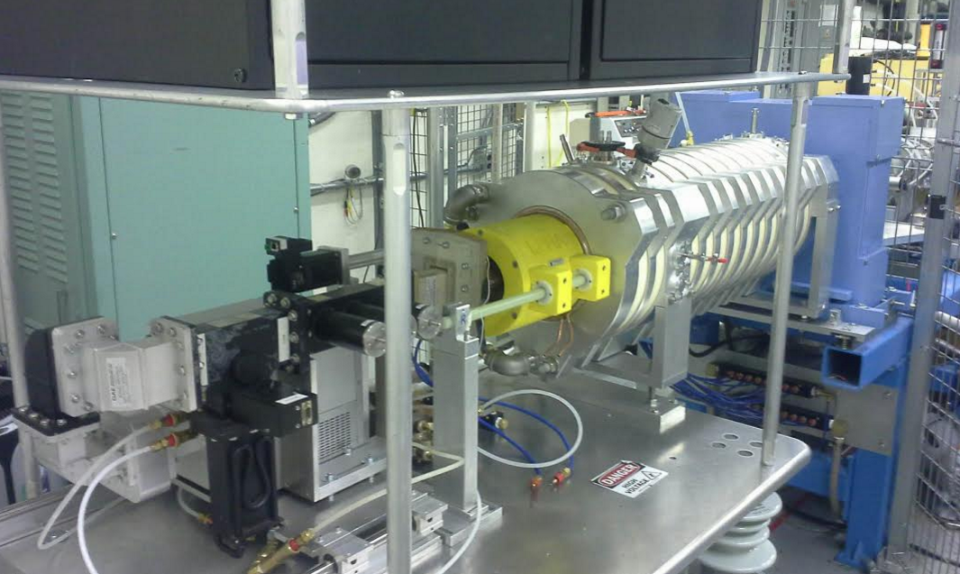
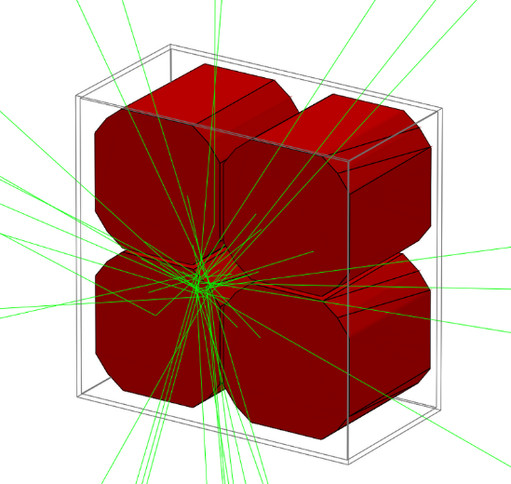
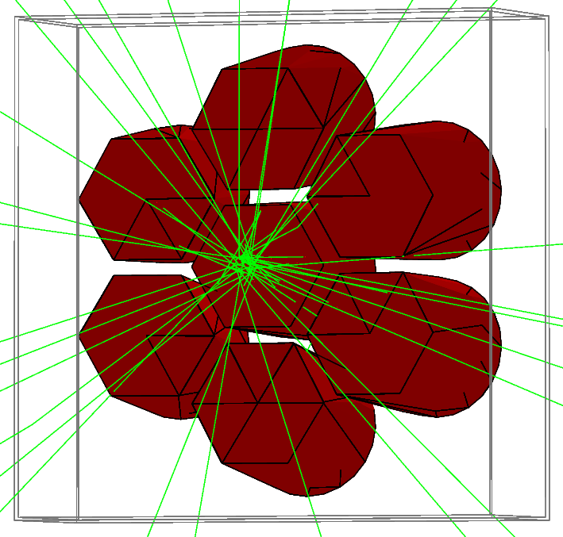
Solutions
Beam pulsing the ECR ion source should allow us to significantly reduce environmental background
Upgrading the detector design could provide a much higher γ-ray detection efficiency
Photo courtesy of Andrew Cooper

Slide 8
Clover
Four P-type coaxial HPGe crystals
70 mm x 70 mm x 70 mm per crystal
Quoted dead layer of .5 mm
γ-ray add-back feature
Roughly $600,000

Slide 9
Cluster Array
Seven P-type coaxial HPGe crystals
78mm in length
Cylinder morphs into hexagonal face
70mm diameter cylinder
61mm flat to flat hexagons
Quoted dead layer of .5mm
Individual Al casing for each crystal
γ-ray add-back capability
Around $1,000,000

Slide 10
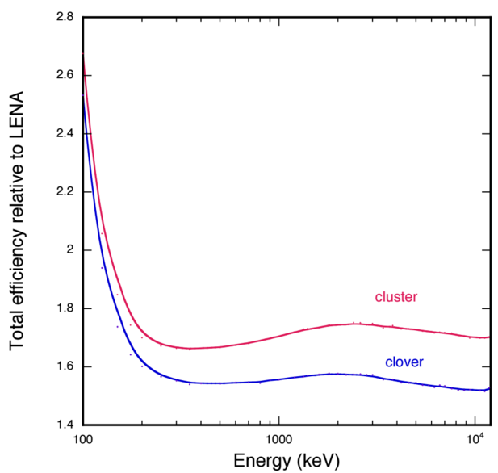
Efficiencies with Respect to LENA
Plots courtesy of A.E. Champagne
Clover and Cluster have peak efficiencies of about 2 and 2.4 times LENA, respectively
Notes:
Graph of ratios

Slide 11
The Next Step
Must simulate background along with signal
Included ⁴⁰K, ²³²Th chain, ^{238U} chain, m+ and m- and fraction fit based on lab background spectrum
Created hypothetical decay for 92 keV resonance in ²⁵Mg(p,γ)²⁶Al
60% branch to ground and 40% branch to isomer (first excited state)
Calculated expected ²⁶Al yield assuming an infinitely thick target, 2 mA of beam and 3 weeks of run time
Should see around 16,000 reactions
Combined this all into a single simulation
Applied γ-γ coincidence gate to reduce background
$$Y_{max,∆E→∞}=\frac{λ_{r}^{2}}{2}\frac{ωγ}{ε_{r}}$$
$$\frac{λ_{r}^{2}}{2}={\left(\frac{M_{0}+M_{1}}{M_{1}}\right)}^{2}\frac{4.125×{10}^{−18}}{M_{0}E_{r}^{lab}}$$
where
(cm²)

Slide 12
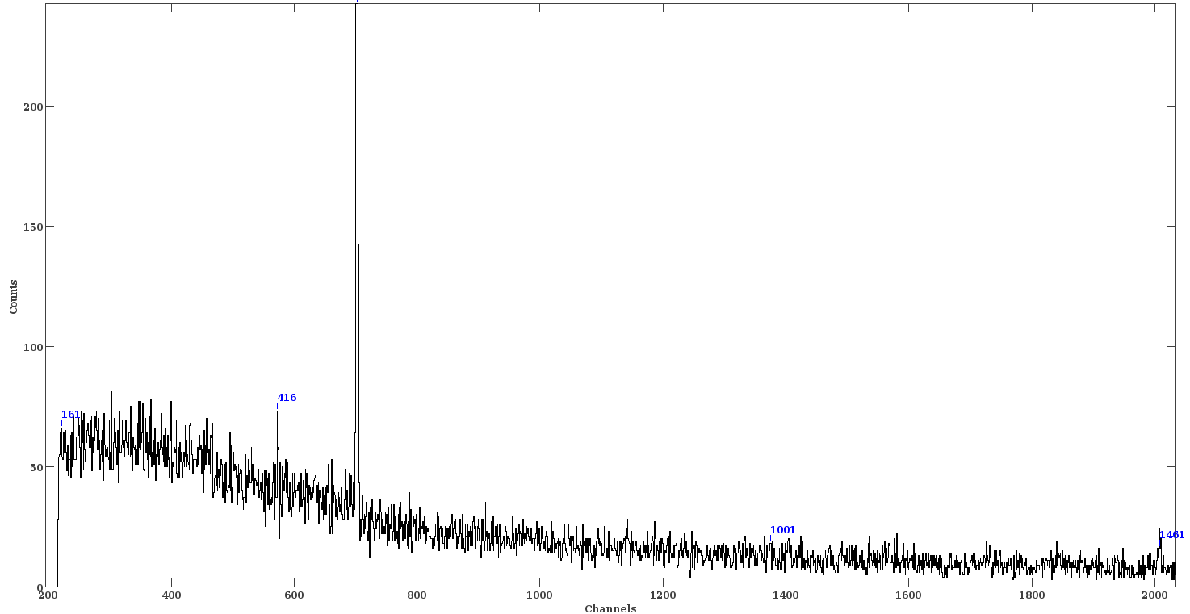
The Clover Falls Short
Clover

Slide 13
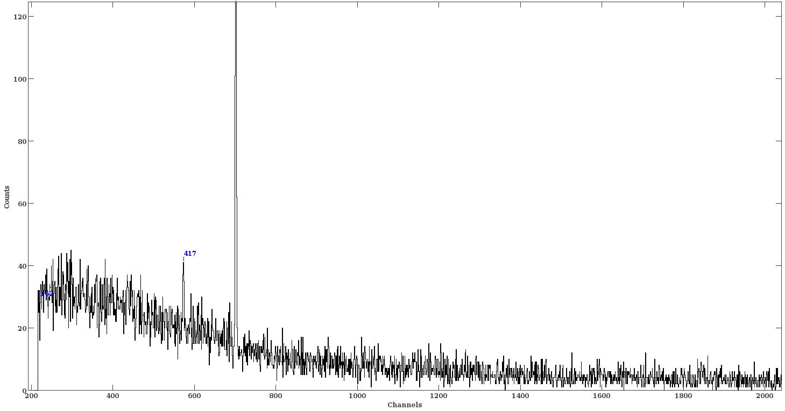
The Clover Falls Short
LENA

Slide 14
What Now?
The clover detector doesn’t appear to provide any advantage for detecting the ²⁵Mg(p,γ)²⁶Al decay signal
Has to do with how the energy gates are set and the γ-ray energies produced by the environmental background and the reaction
Simulating a thicker lead shield around the detector showed a significant increase in low energy background due to Compton scattered events
The only option left is to pulse the ECR ion beam

Slide 15
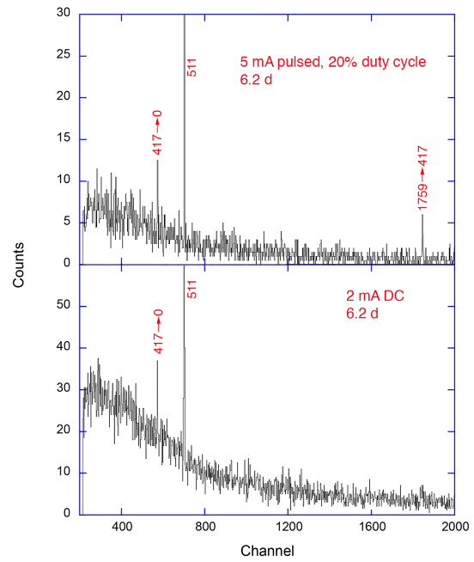
Beam Pulsing
Simulated present detector setup assuming 5 mA of beam pulsed at a 20% duty cycle for 6.2 days
Compared with 2 mA of DC beam
Significant signal improvement can be seen with pulsed beam

Slide 16
Future Plans
Set up a system for tuning on pulsed beam
Measure ²⁵Mg(p,γ)²⁶Al with pulsed ECR beam
Find sweet spot for Pb passive shielding for clover
Write and submit proposal for clover detector
Learn things

Slide 17
Thanks
Art Champagne, Christian Iliadis and Richard Longland
Sean Hunt, Andrew Cooper, Jack Dermigny and Lori Downen
The MAJORANA Demonstrator group at UNC
A special thanks to Reyco Henning and Chelsea Bartram for their assistance, as well as to the DOE for funding this research

Slide 18
References
[1] C. Iliadis, Nuclear Physics of Stars, Wiley-VCH, Weinheim, 2007
[2] G.F. Knoll, Radiation Detection and Measurement, Wiley, New York, 1989
[3] S. Carson, et al., Nucl. Instrum. Methods A: 618 (2010) 190
[4] C. Howard, et al., Nucl. Instrum. Methods A: 729 (2013) 254
[5] S. Agostinelli, et al., Nucl. Instrum. Methods A: 506 (2003) 250

Slide 19
Extra Slides

Slide 20
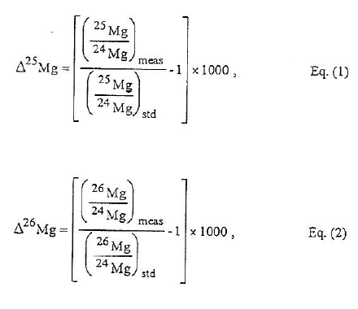
The Whys and Hows
If 26Mg excess in CAIs is due to 26Al, it is possible for these inclusions to serve as chronometers for early solar system events
Isotopic ratios are measured to determine mass excesses of 26Mg and thus 26Al
MacPherson et al. 1995

Slide 21
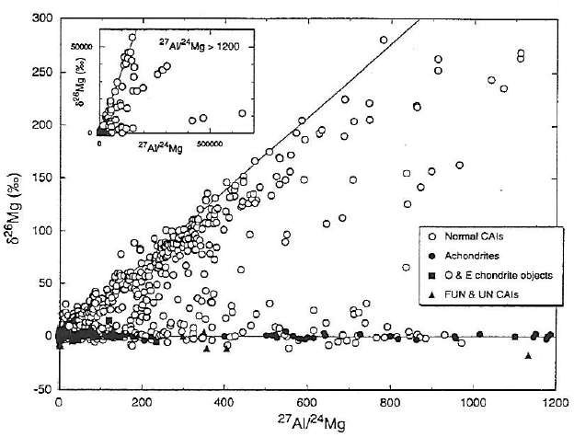
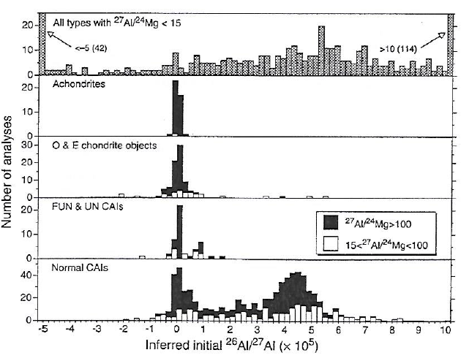
Confusion
26Al/27Al ratios measured from CAI inclusions in Allende meteorite (Lee et al. 1976)
Inclusions appeared to have formed from two separate reservoirs with ratios of 0 and 5x10⁻⁵
MacPherson et al. 1995

Slide 22
The Gold Standard
In fact, it was a single reservoir but lower ratios are due to melting and recrystallization of the meteorite
5x10⁻⁵ is the gold standard corresponding to the initial isotopic ratio of Al injection into the presolar nebula
Assuming this initial value, the age of different CAIs can be determined
This ratio and the aging of CAIs can be very useful tools for unearthing the history of our solar system

Slide 23
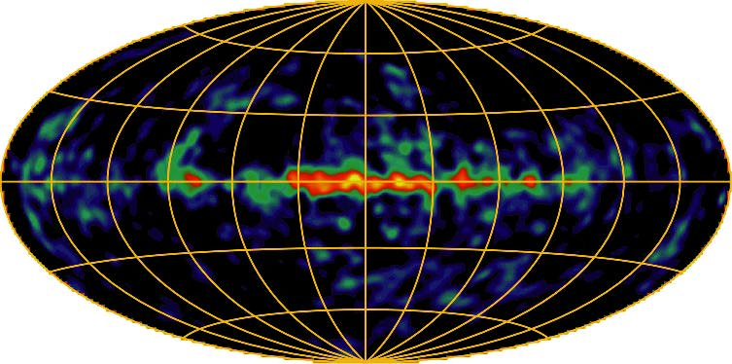
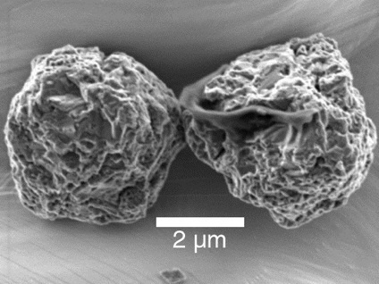
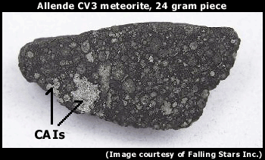
Evidence
Half-life of 7.17 x 10⁵ years
Time scale for galactic evolution is roughly 10¹⁰ years
Short half-life provides a snapshot of the galaxy
Direct observation of 1809 keV γ-ray
26Mg excesses in presolar grains and CAIs
NASA
myriamtelus.files.wordpress.com
Falling Stars Inc.

Slide 24
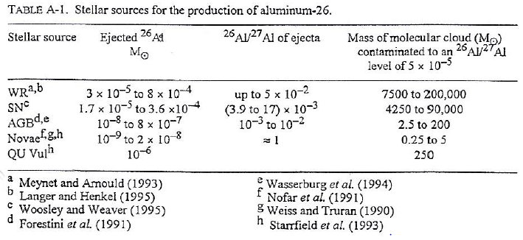
The Source
Big mystery!
Multiple possibilities for synthesis of 26Al
Wolf-Rayet stars
Supernovae
AGB stars
Classical novae
MacPherson et al. 1995

Slide 25
My Focus
Focused primarily on the possibility of 26Al generation from Supernova nucleosynthesis
Explosive Carbon Neon burning in massive stars
Follows directly from Iliadis et al. 2011
Main difference is the analysis of Monte Carlo rate variation on the 26Al/27Al ratio

Slide 26
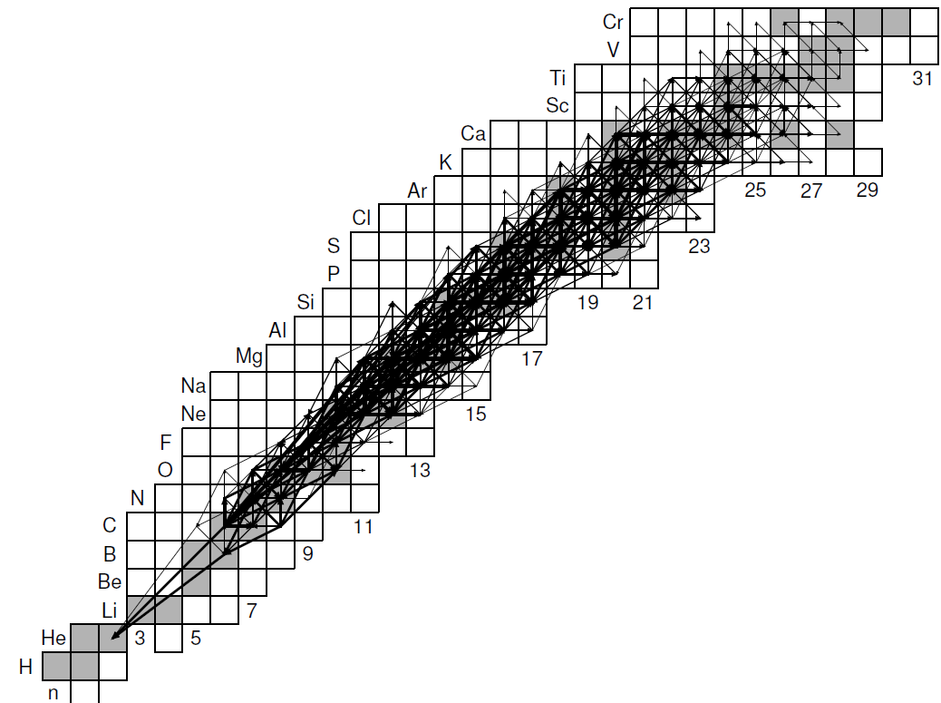
Supernova Flux
Lots of things happen during supernovae

Slide 27
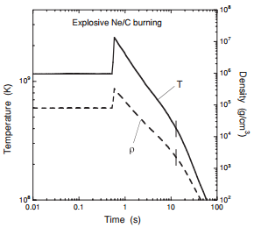
Temperature-Density-Time Comparison
Temperature peaks at around 2.3 GK
26Al production stops at about 12.8 seconds
Iliadis et al. 2011

Slide 28
Temperature-Density-Time Comparison
Density peaks at around 3.2x10⁵ g/cm³
26Al production stops at about 12.8 seconds
Iliadis et al. 2011

Slide 29
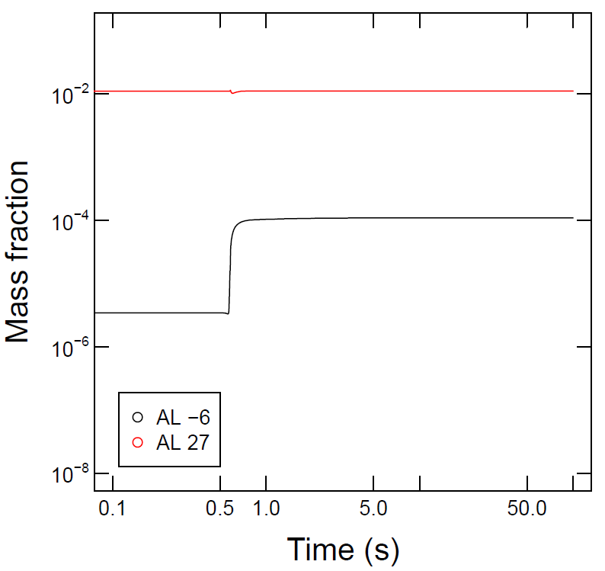
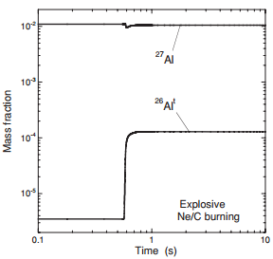
Mass Fraction Comparison
26Al jumps from about 3x10⁻⁶ to 1x10⁻⁴ during the explosion
27Al abundance is roughly unchanged
Iliadis et al. 2011

Slide 30
Effect of Rate Variations on 26Al
²⁶Al(n,p)²⁶Mg

Slide 31
Effect of Rate Variations on 27Al
²⁷Al(α,p)³⁰Si
³⁰Si(p,α)²⁷Al

Slide 32
Effect of Rate Variations on 26Al/27Al
²⁶Al(n,p)²⁶Mg
³⁰Si(p,α)²⁷Al
²⁷Al(α,p)³⁰Si

Slide 33
New Reactions of Interest
The effect of rate variations on the 26Al/27Al ratio has not been explicitly analyzed before
Important reactions established Iliadis et al. 2011 were ²⁶Al(n,p)²⁶Mg, ²⁵Mg(α,n)²⁸Si, ²⁴Mg(n,γ)²Mg and ²³Na(α,p)²⁶Mg
New reactions of interest are ²⁷Al(α,p)³⁰Si and ³⁰Si(p,α)²⁷Al
Resonances for these reactions occur at much higher energies than we can measure at LENA

Slide 34
Other Possibilities
Production of 26Al in massive Wolf-Rayet stars (25 solar mass red giants)
92 keV resonance for ²⁵Mg(p,γ)²⁶Al is an ideal measurement for LENA’s ECR ion source (80 – 200 keV energy range)
Photo courtesy of Andrew Cooper

Slide 35
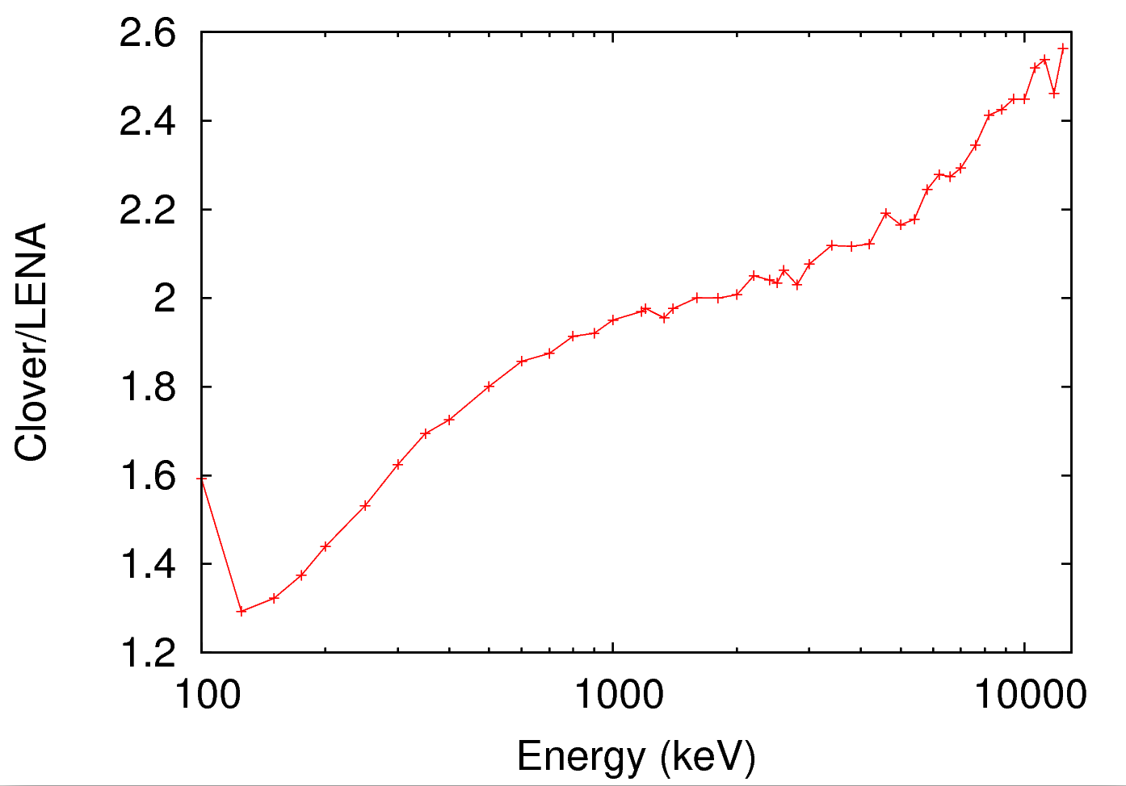
Efficiencies

Slide 36
Final Test
Must simulate background together, along with ²⁵Mg(p,γ)²⁶Al in order to see if the reaction could be observed
Coincidence gating must be applied during analysis in order to mitigate background
However, enough simulations must be run such that the application of coincidence gating does not remove all background statistics
Effectively, about 6 trillion background simulations must be run in order to model 3 weeks worth of beam time

Slide 37
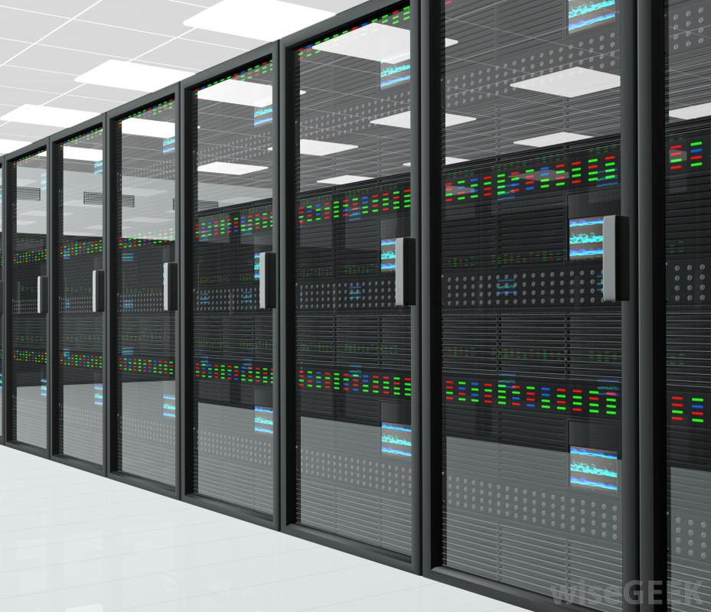
How in the Heck?
New Longleaf computing cluster at UNC
Built for large amounts of parallel jobs each requiring a single compute host
Maximum of 1000 jobs at a time
Free!!!
Photo courtesy of wisegeek.com

